Slide 1




G.H. RAISONI COLLEGE OF ENGINEERING
AND MANAGEMENT, WAGHOLI, PUNE.
Department of AI & AIML
ONLINE FOOD DELIVERY
Guided By : Prof .Nutan Raut
Name of Projectees
Nageshkumar Kokane Soham Naik
Mahesh Kalle

Slide 2
Contents
Introduction
Justifications for Selecting the Title
Problem Statement
Literature Survey
Block Diagram
Expected Result
Work plan
References

Slide 3
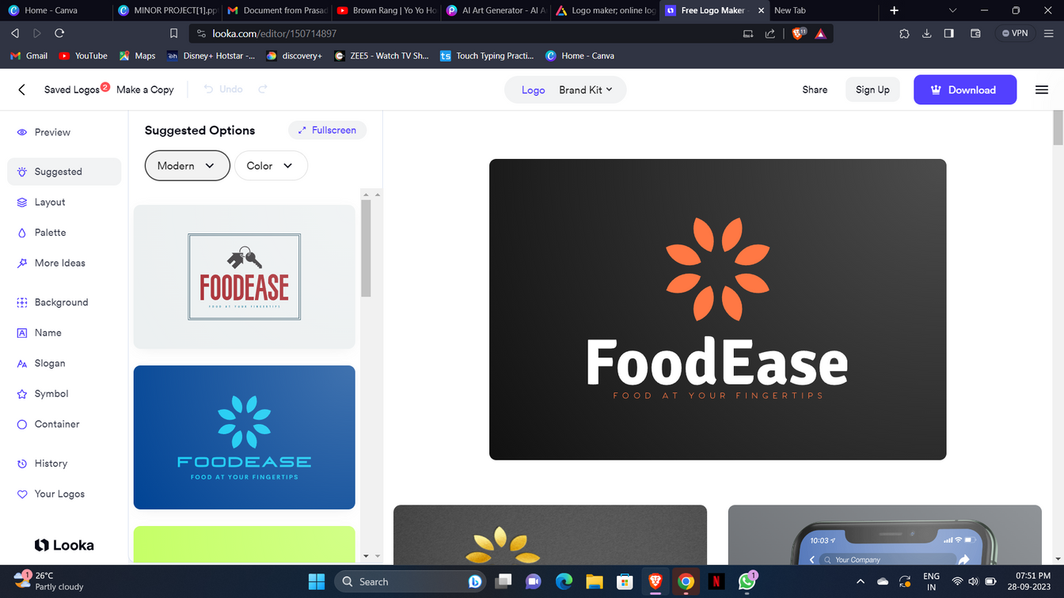
Introduction
Welcome FoodEase
(Food at your fingertips)
Indulge in the ultimate dining convenience. We bring the world of flavors to your doorstep. Say goodbye to cooking and queuing – say hello to a world of culinary delights at your fingertips.
Explore & Savor: Discover a diverse menu featuring your favorite local eateries and international cuisines. From comfort classics to exotic flavors, there's something to satisfy every craving.
Effortless Ordering: Ordering is a breeze with our user-friendly platform. Customize your meal, choose your delivery options, and complete your order in just a few clicks.

Slide 4
Justification For Selecting The Title
The title FoodEase is a well-considered choice for several reasons. Firstly, it succinctly conveys the website's primary function, instantly informing users that it's a platform for food delivery. This clarity is essential for attracting and retaining customers.
Secondly, the title is memorable and easy to recall, which is crucial for repeat business. When customers think of ordering food, they are more likely to remember and return to a website with a straightforward name like this.
Furthermore, incorporating the website's name into the title is a smart branding move. It reinforces the website's identity and helps build trust and recognition among users.
From an SEO perspective, the title includes relevant keywords such as "food delivery," which can improve the website's visibility in search engine results. This makes it more likely that potential customers will discover the website when searching for food delivery options online.
In summary, FoodEase is a customer-centric, brand-reinforcing, SEO-friendly, and memorable title choice that aligns perfectly with the website's purpose and marketing efforts.

Slide 5
Problem Statement
Develope an online food delivery website that provides user with a user -friendly delivery
The website should allow customers to browse through a wide range of foods view detailed food information.
Additionally,the website should have an efficient search and filtering system to help users find products quickly.
User will find all their need in one place because all websites are included in one website like Zomato and Swiggy
Implement SEO optimization for the click and order food website to improve its online visibility and attract more local clients.

Slide 6
Literature Survey
Sr. No. | Paper Title and its Author | Details of Publication | Findings
1
2

Slide 7
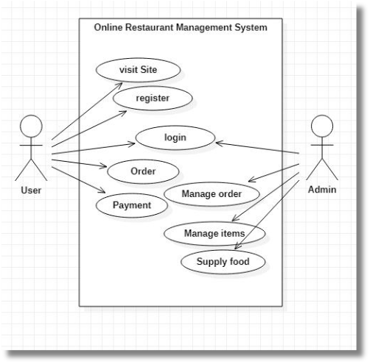
Block Diagram

Slide 8


Key Feature
Key Features
Key Features of the Website
Easy Navigation
Quick Order Processing
Advanced Filtering
Our website is designed with a clean and intuitive interface, making it easy to search for your favorite food or browse by cuisine.
a offer advanced filtering options to help you find exactly what you're looking for. Filter by price, rating, cuisine type, and more.
Our streamlined ordering system ensures that orders are processed quickly and efficiently.

Slide 9
Expected Result
Foodease aims to achieve customer satisfaction and operational excellence as its primary outcomes and goals.
It sets benchmarks for exceptional customer satisfaction, pinpoint order accuracy, and optimized delivery efficiency.
Success in Foodease is measured through metrics such as Net Promoter Score (NPS), order error rates, and on-time delivery performance.
Key measurements include analyzing customer feedback, tracking order accuracy percentages, and monitoring delivery time variances for continuous improvement.

Slide 10
Work – Plan
Months Activities | August’23 | Sept’23 | Oct’23 | Nov’23
Literature Reviews | √
Requirement Analysis | √
Designing | √
Experimental Analysis | √ | √ | √
Module wise Implementation |  | √ | √
Testing and Debugging |  |  | √ | √
Preparation of Project Report |  |  |  | √

Slide 11
References
Properly citing sources and references is essential to acknowledge the foundation of research and development in Foodease, fostering transparency and credibility.
In-depth links and comprehensive bibliographic information facilitate further reading and validation, enriching the knowledge base for ongoing enhancements.
Recognizing and crediting the valuable contributions of external projects and resources strengthens collaboration and ensures a well-rounded approach to Foodease's development.
Incorporating a robust citation and attribution system not only complies with ethical standards but also nurtures a culture of intellectual integrity within the Foodease team and its collaborators.

Slide 12
Thank You!

